Slide 1
PEARL HARBOR
THE DAY OF INFAMY
December 7, 1941

Slide 2
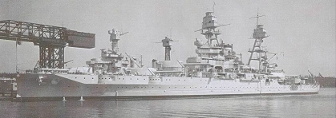
USS Arizona

Slide 3
Causes…
The U.S. demanded that Japan withdraw from China and Indochina
Japan thought that attacking the U.S. would provide them an easy win, and a territory with abundant land and resources to rule once they were victorious.
The U.S. oil embargo against Japan was hurting Japan’s economy

Slide 4
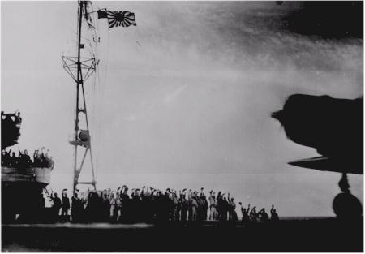

Slide 5
USS Arizona

Slide 6
Major Combatants
Japan
Fleet of 6 Aircraft Carriers under the command of Admiral Nagumo and Admiral Yamamoto
Aerial Assault Force under the command of Mitsuo Fuchida
United States
- Pearl Harbor Naval/Army Base under the command of Admiral Husband E. Kimmel and Lt. General Walter C. Short

Slide 7
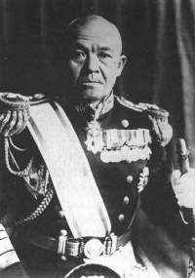
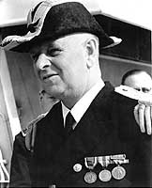
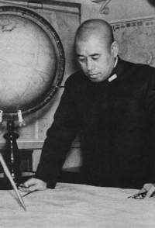

Slide 8
Battle Sequence
5 PHASE ATTACK BY JAPANESE…
(as noted by the U.S. Navy)
PHASE 1: Combined torpedo plane and dive bomber attacks lasting from 7:55 a.m. to 8:25 a.m.
PHASE 2: Lull in attacks lasting from 8:25 - 8:40 a.m.
PHASE 3: Horizontal bomber attacks from 8:40 – 9:15 a.m.
PHASE 4: Dive bomber attacks between 9:15-9:45 a.m.
PHASE 5: Warning of attacks and completion of raid after 9:45 a.m.

Slide 9
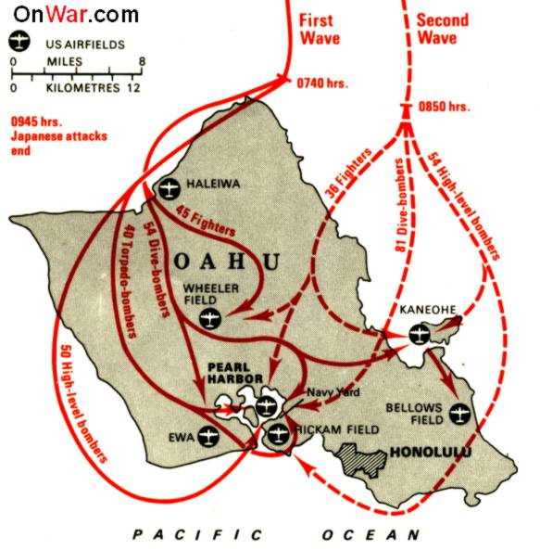

Slide 10
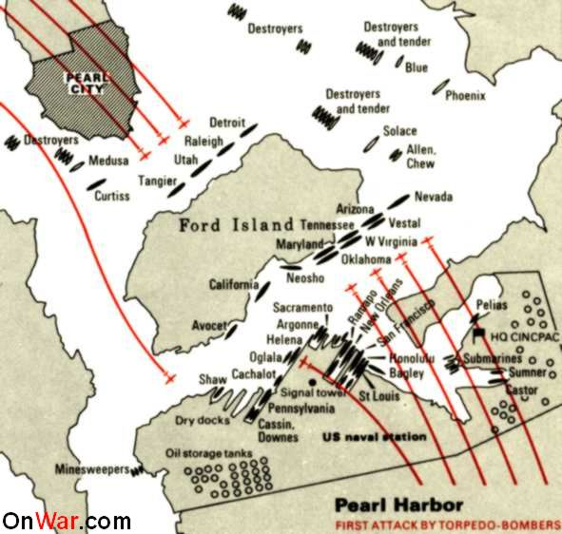

Slide 11
Eyewitness Account
Commander Mitsuo Fuchida
“Veering right toward the west coast of the island, we could see that the sky over Pearl Harbor was clear. Presently the harbor itself bacame visible across the central Oahu plain, a film of morning mist hovering over it. I peered intently through my binoculars at the ships riding peacefully at anchor. One by one I counted them. Yes, the battleships were there all right, eight of them! But our last lingering hope of finding any carriers prestent was now gone. Not one was to be seen.”

Slide 12
Warfare Used During Attack
Japan
81 Fighter Planes
135 Dive Bombers
104 Horizontal Bombers
40 Torpedo Planes
At least 5 Midget Submarines

Slide 14
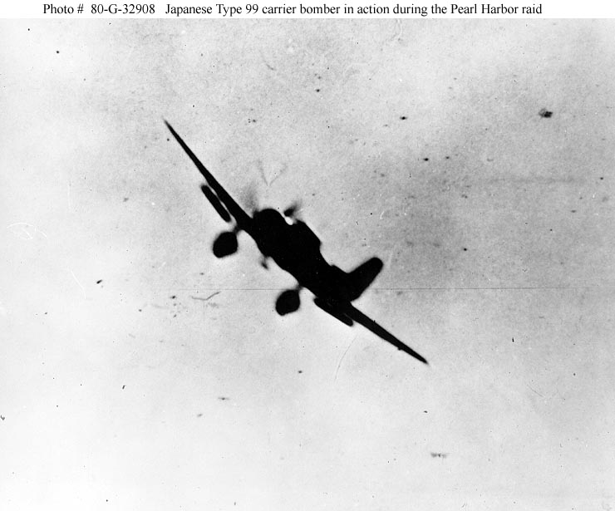

Slide 15
Warfare (continued)
United States
108 Fighter Planes (59 not available for flight)
35 Army Bombers (27 not available for flight)
993 Army/Navy Antiaircraft Guns

Slide 16
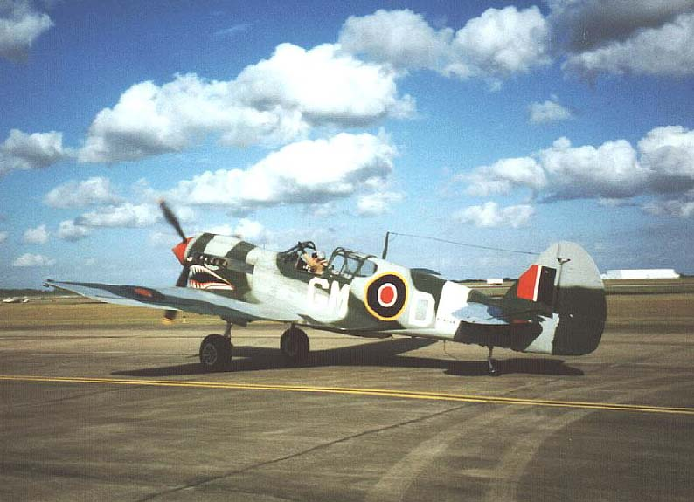

Slide 17
Casualties
Japan
Less then 100 men
29 planes
5 midget submarines
United States
2,335 servicemen killed, 68 civilians killed, 1,178 wounded
188 planes
18 ships (8 battleships, 3 light cruisers, 3 destroyers, 4 other vessels)

Slide 18
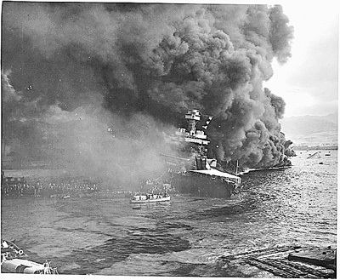
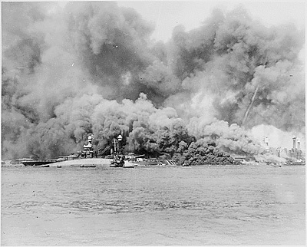
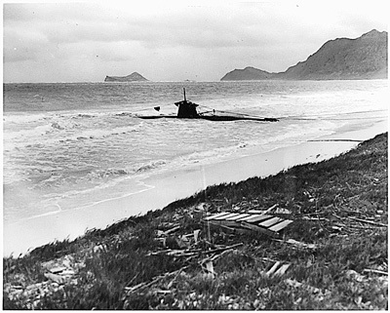
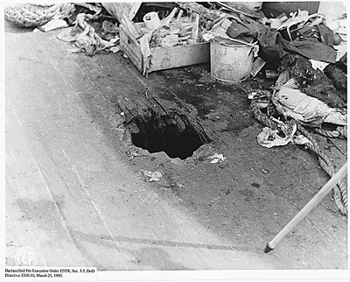

Slide 19
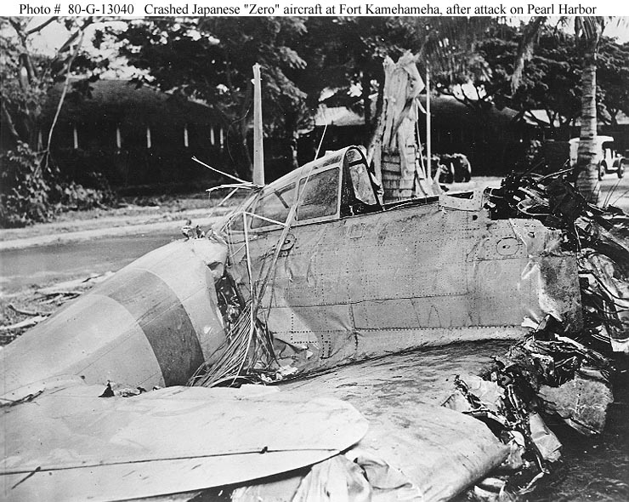

Slide 20
USS Arizona Burning: 1,100+ servicemen died on the ship

Slide 21
Eyewitness Account
Marine Corporal E.C. Nightingale
“I was about three quarters of the way to the first platform on the mast when it seemed as though a bomb struck our quarterdeck. I could hear shrapnel or fragments whistling past me. As soon as I reached the first platform, I saw Second Lieutenant Simonson lying on his back with blood on his shirt front. I bent over him…He was dead…”

Slide 22
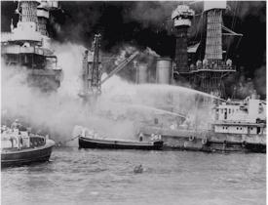
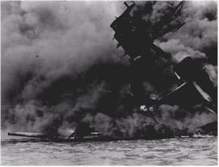

Slide 23
Eyewitness Account
Lt. Ruth Erickson, USN (Nurse)
“The first patient came into our dressing room at 8:25 a.m. with a large opening in his abdomen and bleeding profusely. They started an intravenous and transfusion. I can still see the tremor of Dr. Brunson’s hand as he picked up the needle. Everyone was terrified. The patient died within the hour.”

Slide 24
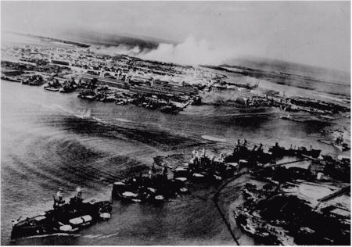

Slide 25
Effects/Outcome
Japan dealt a seemingly crippling blow to the U.S. Pacific fleet (U.S. Pacific Fleet aircraft carriers: Lexington, Enterprise, & Saratoga were not in port)
Japan began their quest for a Pacific empire
The U.S. finally was forced to join World War II (“The Sleeping Giant was awakened”)
The U.S. & Great Britain declare war on Japan (Dec. 8, 1941)
Germany & Italy declare war on the U.S. (Dec. 11, 1941)

Slide 26
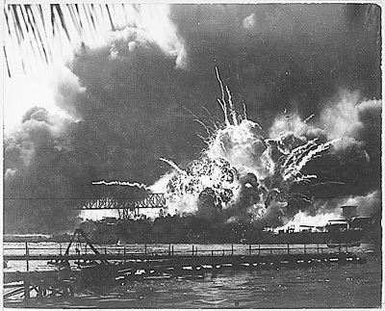

Slide 27
December 8, 1941 FDR Speech
“Yesterday, Dec. 7, 1941 - A date which will live in infamy – the United States of America was suddenly and deliberately attacked by naval and air forces of the Empire of Japan.”
FDR Infamy Speech

Slide 28
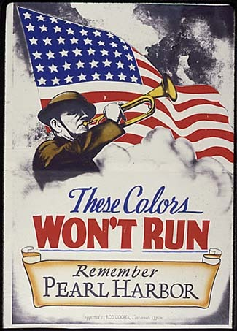
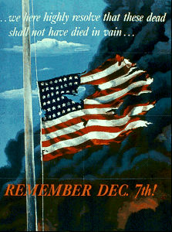

Slide 29
Works Cited
http://www.combinedfleet.com/btl_ph.htm
http://members.aol.com/TeacherNet/WWII.html#Pearl
http://www.historyplace.com/worldwar2/timeline/pearl.htm
ftp://ftp.rootsweb.com/pub/usgenweb/hi/military/pearl.txt
http://www.ibiblio.org/pha/pha/congress/part_2.html
http://www.history.navy.mil/faqs/faq66-3b.htm
http://www.eyewitnesstohistory.com/w2frm.htm
http://history1900s.about.com/library/photos/blyindexpearl.htm
http://www.faqfarm.com/Q/What_were_the_causes_of_Pearl_Harbor
http://www.umkc.edu/lib/spec-col/ww2/PearlHarbor/fdr-speech.htm#doi

Slide 30
This powerpoint was kindly donated to www.worldofteaching.com
http://www.worldofteaching.com is home to over a thousand powerpoints submitted by teachers. This is a completely free site and requires no registration. Please visit and I hope it will help in your teaching.

